Slide 1
First Day of School
Essential Question: Insert essential question here.
Alpha Circle
Debrief Questions:
What was challenging about this activity?
What strategies did you use? What could you have tried?
Besides being given the ability to speak, what would have made this activity easier?
Seat yourselves in alphabetical order by last name without ANY talking.
You may use any other method you choose.....just no talking.
LG:

Slide 2
First Day of School
LG: Introduce ourselves and the course and examine the AVID binder requirements.

Slide 3
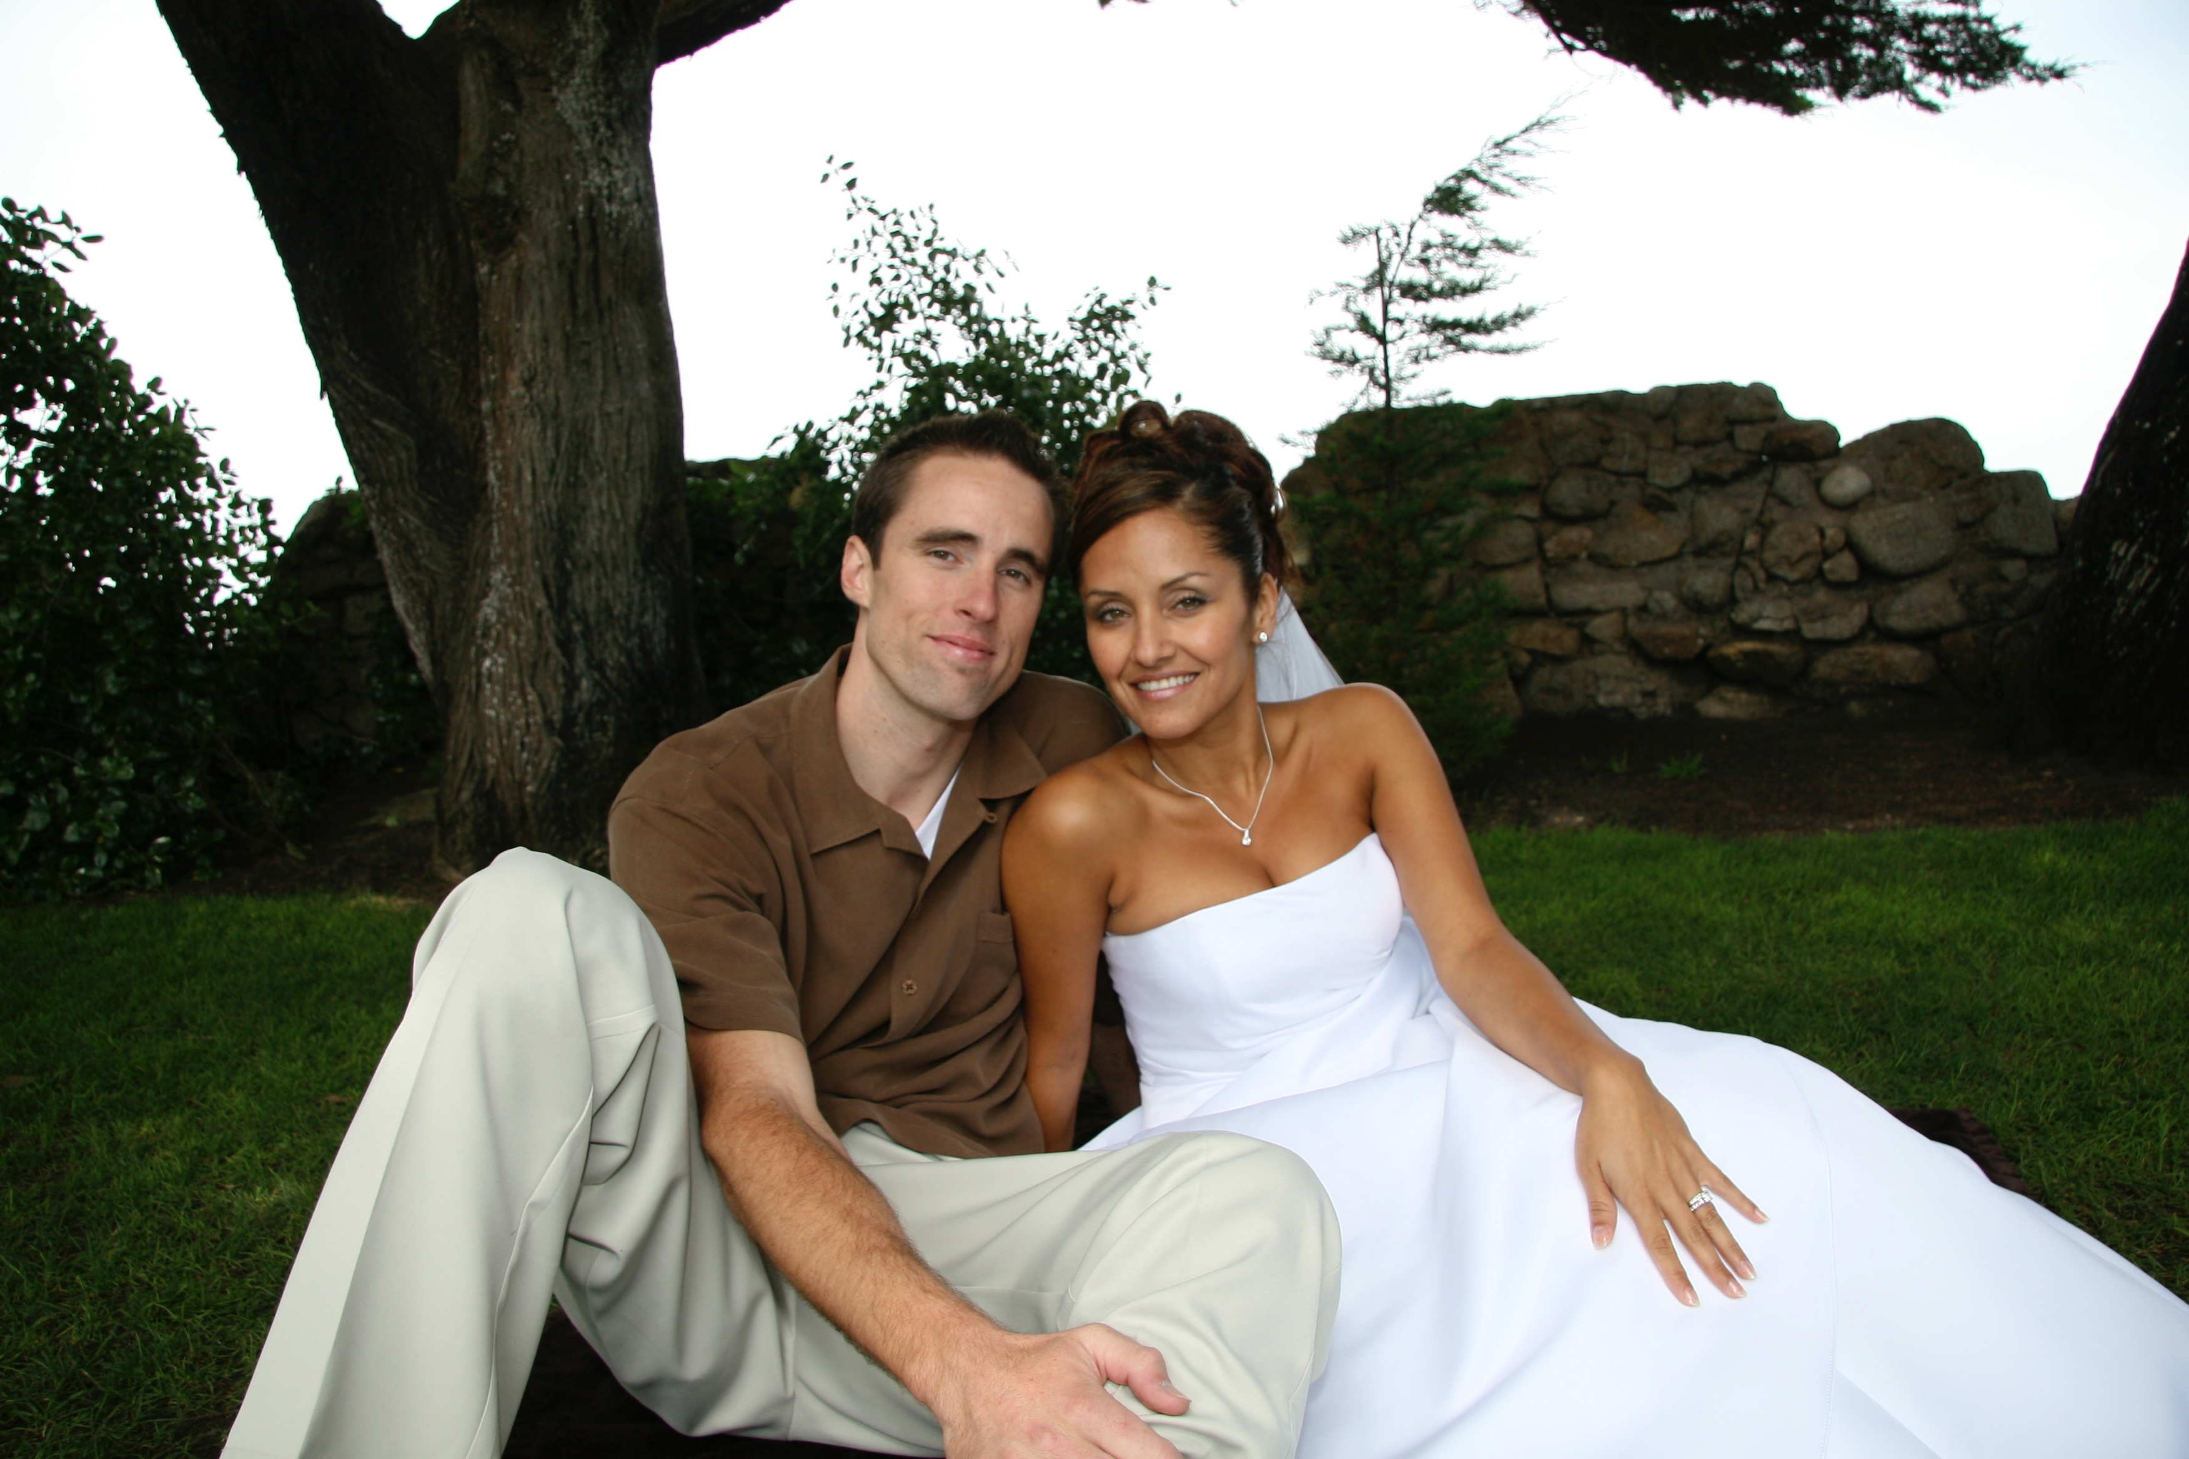
Who Am I?
Mr. McGuffee
12 years teaching -- Colton Middle
7th Grade Advanced World History, AVID 7
Love to teach and travel
Proud daddy.......Sophia Bella and Gianna Bella

Slide 4
Introductions...Who Are You?
Name
Table Teepee Instructions
On BOTH sides, use color to write your name large, in the middle, and in color.
On ONE side,write:
Top left – Which elementary school you attended
Top right – Your favorite school subject
Bottom left – Why AVID?
Bottom right – A symbol that represents your life, interests, passion, etc.
Choose 4 questions from the handout to respond to on the inside of your table teepee.
Set up 4 Seasonal Conversations
Hold 4 conversations, one with each Seasonal Conversation. (Introduce self, tell which question and how answered.)
Name

Slide 5
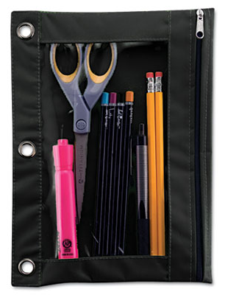
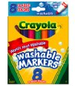
First Day of School
Essential Question: What are the binder requirements for an AVID student?
Study
Questions
Importance of the Binder
Read "The Importance of Your Binder" quietly to yourself, circling 5-10 key terms.
LG: Introduce ourselves and the course and review the importance of the binder.

Slide 6
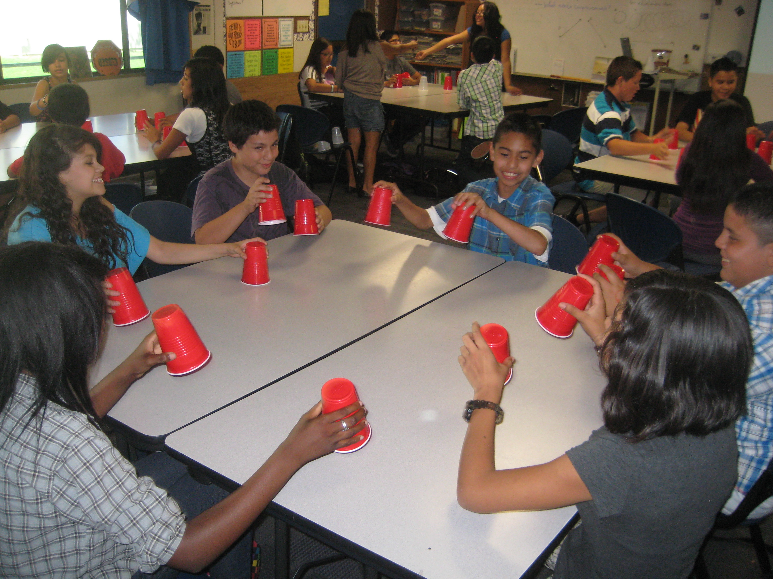
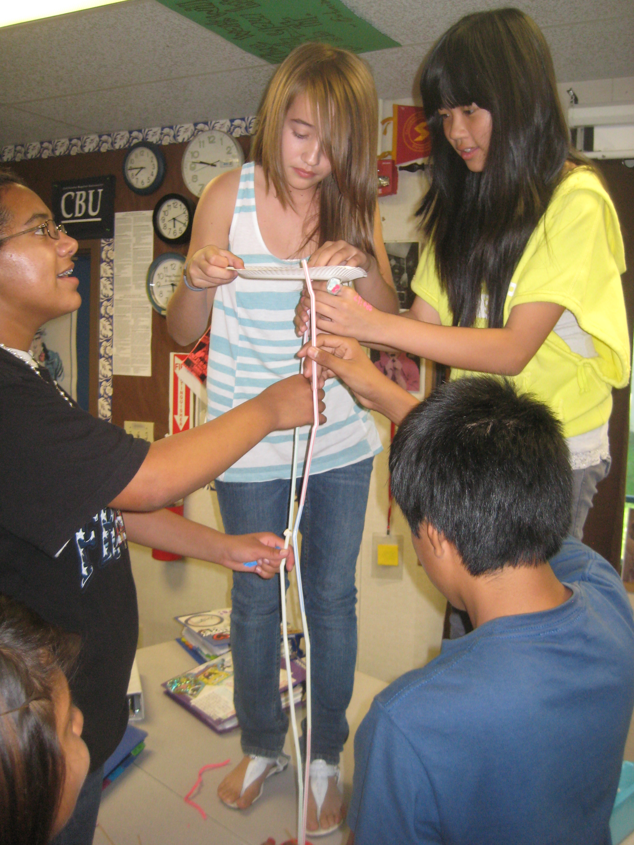
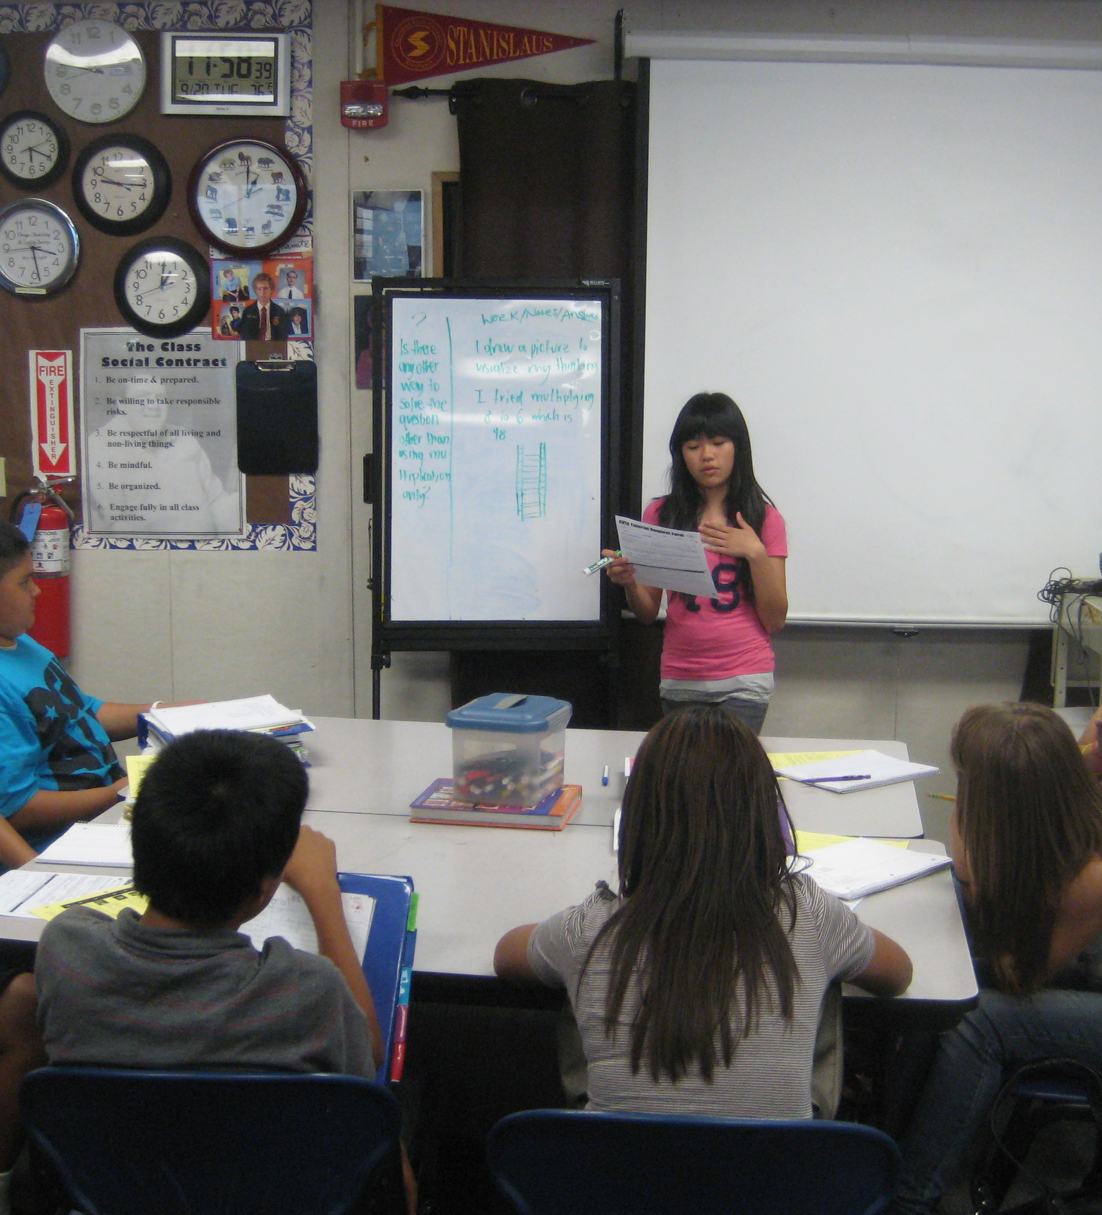
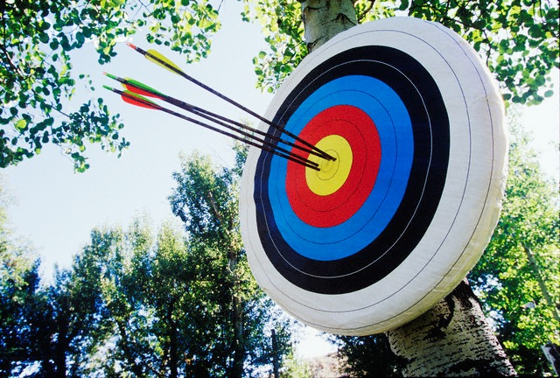
AVID Training Camp
LG: Become familiar with the mission of AVID and make connections between a training camp and what we will do in the 1st quarter.

Slide 7
Training Camp Overview
Essential Question: what is AVID and what will we be doing on AVID in the 1st quarter?
Study
Questions
A
V
I
D
dvancement
ia
ndividual
etermination
LG: Become familiar with the mission of AVID and make connections between a training camp and what we will do in the 1st quarter.
[L. avidus]: eager for knowledge
In a nutshell, AVID exists to help students become college-ready so they can live their college dream.

Slide 9
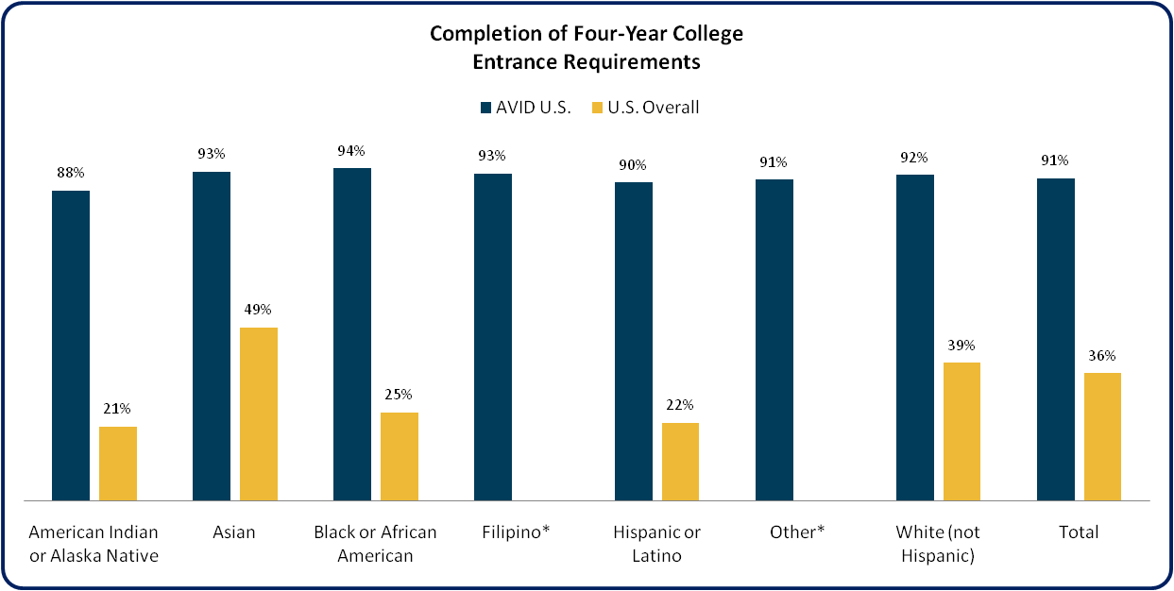
AVID Closes the Achievement Gap
for ALL Students
AVID Center. AVID Senior Data Collection. Study of 22,210 AVID Seniors, [Electronic Database]. (2009 - 2010).
Manhattan Institute, Education Working Paper 3. 2003. Greene, J.P., Forster, G. "Public High School Graduation and College Readiness Rates in the U.S.“ (The most recent national data available.) *Filipino and Other not classified in Manhattan Institute study.

Slide 10
First Day of School
College Readiness
Achieving Your College Dream
Living a Life of Excellence
Essential Question: What are the AVID binder requirements and why is the binder soooooo important?
Study
Questions
Reach
Teach
Personal
Development
Togetherness
Rigor
Writing
Inquiry
Collaboration
Organization
Reading
Support
Tutorials
AVID ER
LG: Become familiar with the mission of AVID and make connections between a training camp and what we will do in the 1st quarter.
The Whole Student

Slide 11
More than 30 years of success
In just over 30 years, AVID has become one of the most successful college-preparatory programs in America, and today reaches more than 425,000 students in approximately 4,800 schools in 48 states and 16 other countries/territories.
Since 1990, more than 110,000 AVID students have graduated from high school and planned to attend college.
Notes:
AVID also has students in 24 postsecondary institutions.

Slide 12
Where in the world is AVID?
*Numbers as of 10/1/11
Notes:
[FROM SLIDE 3]: adopted by more than 4,800 schools in 48 states and 16 countries

Slide 13
Demographics: 2011 AVID seniors
Parent’s Highest Level of Education

Slide 14
Ethnic breakdown of AP® test-takers
The rate of Latinos taking AP exams is over four times higher among AVID students than among U.S. students overall.
AVID Senior Data Collection 2010-2011, AVID Seniors Taking an AP Course, n = 26,407
COMPARATOR: College Board AP Exams National Summary Report
http://www.collegeboard.com/student/testing/ap/exgrd_sum/2010.html
Notes:
Opening access to Advanced Placement courses for all students, regardless of ethnicity or economic background, is essential to leveling the academic playing field. AVID students, who take many AP tests every year, show greater ethnic diversity than AP test-takers do overall. The proportion of Latinos taking AP exams is over four times higher among AVID students than among U.S. students overall. [IS THIS SUPPOSED TO SAY “FOUR TIMES GREATER THAN OTHER LATINOS OVERALL”? IF SO, I HAVE THE ARROW POINTED TO THE WRONG NUMBER AND THE STAT IS INCORRECT.]
ALSO, I’VE MOVED THE DETAILED SOURCE INFORMATION OFF THE SLIDES AND PUT IT INTO THE NOTES, LIKE SO:

Slide 15
Completing college-entrance requirements
AVID students complete four-year college entrance requirements at a rate at least two times higher than
the national rate.
AVID Senior Data Collection 2010-2011, AVID CA n = 15522; AVID TX n = 3923; AVID NC n = 709; AVID IL n = 1307; AVID FL n = 1117
COMPARATOR: U.S. Overall: The Manhattan Institute for Policy Research, Center for Civic Innovation, Education Working Paper No. 8 February 2005, Jay P. Greene and Marcus A. Winters

Slide 16
This Year You Will...
Develop as readers and writers
Develop deep content knowledge
Know content specific strategies for reading, writing, thinking, and talking
Develop habits, skills, and behaviors to use knowledge and skills
Notes:
To help all students do rigorous work and meet or exceed high standards in each content area, we must help students:

Slide 17
First Day of School
Essential Question: Insert essential question here.
Study
Questions
Topic
Notes
Instructions
LG:

Slide 18
AVID Training Camp
Essential Question: what is AVID and what will we be doing on AVID in the 1st quarter?
Study
Questions
Training Camp
What experiences do you have with training camp? Brainstorm in your notes everything your table knows about training camp.
2. What is the goal/are the goals of training
camp?
LG: Become familiar with the mission of AVID and make connections between a training camp and what we will do in the 1st quarter.
We will use the theme/analogy of training camp to define or work in the first quarter.

Slide 19
Training Camp Overview
Essential Question: what is AVID and what will we be doing on AVID in the 1st quarter?
Study
Questions
Training Camp
As you watch this clip from the movie "Remember the Titans," keep track of of the various elements of training camp you see. Keep in mind the telos (purpose/goal) of what they are doing.
Video Clip | AVID Class
* Coach has a play book everyone must know. * Sets high goals. * Interview each other * Works them hard to achieve perfection. * Instill a "new normal" | * learn AVID essentials * understand our mission in AVID and set goals for the year * lots of team-building activities to break down barriers * get in academic shape *
What did the coach do @ training camp?
Why did he do it?
What were the results? What changes did you see in the team?
What barriers did the coach and team face?
LG: Become familiar with the mission of AVID and make connections between a training camp and what we will do in the 1st quarter.

Slide 20
AVID Training Camp
Essential Question: what is AVID and what will we be doing on AVID in the 1st quarter?
Study
Questions
Philosophical Chairs
The coach (Coach Boone) is too hard on the players.
Instructions
Do you agree or disagree with this statement? Explain your response in your notes.
LG: Become familiar with the mission of AVID and make connections between a training camp and what we will do in the 1st quarter.

Slide 21
AVID Training Camp
Essential Question: what is AVID and what will we be doing on AVID in the 1st quarter?
Study
Questions
AVID Essentials
Cornell Notes
Tutorials
Binder Organization and Evaluation
Group Identity
LG: Become familiar with the mission of AVID and make connections between a training camp and what we will do in the 1st quarter.

Slide 22
AVID Training Camp
Essential Question: Insert essential question here.
Study
Questions
A Typical Week in AVID
Notes
Monday | Tuesday | Wednesday | Thursday | Friday
Projects, AVID curriculum, academic skill-building, critical reading and writing | Tutorials | Projects, AVID curriculum, academic skill-building, critical reading and writing | Tutorials, Binder Check | Team-building, Guest Speakers, Structured Discussions, College Research
Instructions
LG: Become familiar with the mission of AVID and make connections between a training camp and what we will do in the 1st quarter.

Slide 23
First Day of School

Slide 24
Lesson Title
EQ: ?
Study
Questions
Instructions:
Topic
Notes
LG:

Slide 25
Lesson Title
Essential Question: Insert essential question here.
Study
Questions
Topic
Notes
Instructions
LG:

Slide 26
Lesson Title

Slide 27
Lesson Title
EQ: ?
Study
Questions
Instructions:
Topic
Notes
LG:

Slide 28
How ToTake Cornell Notes
LG: Describe the steps used to take Cornell Notes.

Slide 29
How To Take Cornell Notes
Essential Question: Insert essential question here.
Study
Questions
Topic Date Essential Question/Learning Goal
Write questions about your notes (quiz, clarify, go deeper) Write key terms. | Take notes during the lesson -- use pictures, bullet points, abbreviations, graphic organizers, etc. -- space your notes out, leave room to come back and add info.
Instructions
LG: Describe the steps used to take Cornell Notes.

Slide 30
Quickwrite
What is something at which you used to be good but now you’re not as good?
Why aren’t you as good now?
Write for three minutes on this topic.

Slide 31
Memorize These 10 Items
Bubble gum
Eraser
Mockingbird
William Shakespeare
Neon green
43
Notebook paper
Botany
War of 1812
Great Uncle

Slide 32
Quiz
You have 30 seconds to study
Write down the 10 Items

Slide 33
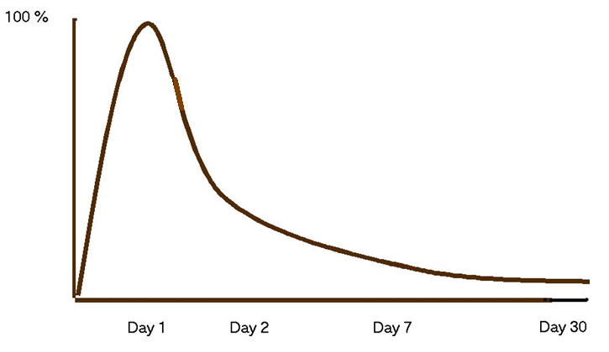
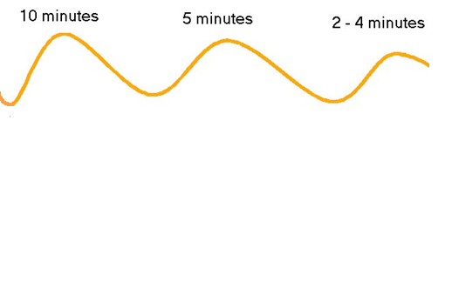
The Curve of Forgetting
Instructions: Read "The Curve of Forgetting."
As you read, think about the following questions:
When it comes to remembering, what is the problem
and what is the solution?
Percent
Retention
of
Material
Elapsed Days
Notes:
This slide illustrates

Slide 34
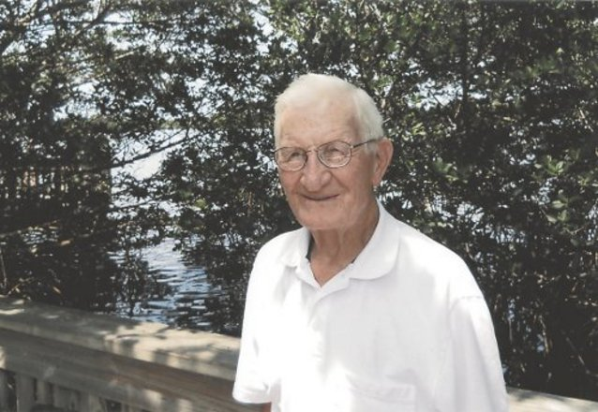
How To Take Cornell Notes
Essential Question: Insert essential question here.
Study
Questions
A
Brief History of Cornell Notes Started by a professor at Cornell University in 1947 in response to struggles his students had in retaining information.
LG: Describe the steps used to take Cornell Notes.

Slide 35
How To Take Cornell Notes
Essential Question: Insert essential question here.
Study
Questions
C
reate Format | Fold your paper to create a column on the left ~2 1/2 in. from left. Draw in the line. Add the Lesson Title, date in ink, and learning goal or essential question on the top or second line.
Topic Date Essential Question/Learning Goal
Study Questions 2 -- 2 1/2 in. | Notes
LG: Describe the steps used to take Cornell Notes.

Slide 36
How To Take Cornell Notes
Essential Question: Insert essential question here.
Study
Questions
O
rganize Notes on the Right-Hand Side
LG: Describe the steps used to take Cornell Notes.

Slide 37
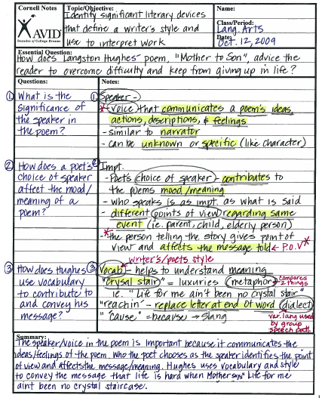
How To Take Cornell Notes
Essential Question: Insert essential question here.
Study
Questions
R
eview & Revise Your Notes | This step is HUGE because everything else you will do to your notes depends on it. Re-read your notes -- as you read them: 1. Add stuff you remember 2. Draw pictures 3. Use arrows to make connections 4. Think about what the main ideas are-- # and underline them 5. Circle or highlight 5+ key terms.
#
LG: Describe the steps used to take Cornell Notes.

Slide 38
How To Take Cornell Notes
Essential Question: Insert essential question here.
Study
Questions
N
ote Key Ideas to Write Questions on the Left | Now that you have re-read your notes, it is time to write questions in the left-hand column. There are 3 basic types of questions you might ask: 1) Study/Quiz Questions (The answer or information is there in your notes and you will use these to study) 2) Clarify Questions (About stuff in the lesson you don't understand...write it down so you can ask your teacher) 3) Go Deeper Questions (About stuff you are curious about that relates to the lesson or level 2-3 questions that will enlarge your understanding of the topic...ask these questions during the next class period, if appropriate, to get a discussion going. These questions let you take charge of your learning.)
LG: Describe the steps used to take Cornell Notes.

Slide 39
How To Take Cornell Notes
Essential Question: Insert essential question here.
Study
Questions
E
xchange Ideas | Talk to your classmates abut what each of you got in your notes. Add information you missed in another color.
LG: Describe the steps used to take Cornell Notes.

Slide 40
How To Take Cornell Notes
Essential Question: Insert essential question here.
Study
Questions
L
ink Learning to Write a Summary at the End | Summarize your notes at the end. I recommend drawing a horizontal line to separate your summary from the notes. You should have circled 5-7 key terms during "Step R"-- Use them in your summary. Do (1) Learn (2-4) Interesting (1) Questions (1)
LG: Describe the steps used to take Cornell Notes.

Slide 41
How To Take Cornell Notes
Essential Question: Insert essential question here.
Study
Questions
L
earning Tool | Minutes studying the notes you took that same day to review and revise, write q's and a summary (DLIQ) Hours later, spend 5-10 more minutes studying the same notes. Review highlighted info, and use left-side questions to quiz yourself. Days later, review notes again to make sure you still got it.
10
24
LG: Describe the steps used to take Cornell Notes.
7

Slide 42
Lesson Title
Essential Question: Insert essential question here.
Study
Questions
Topic
Notes
Instructions
LG:

Slide 43
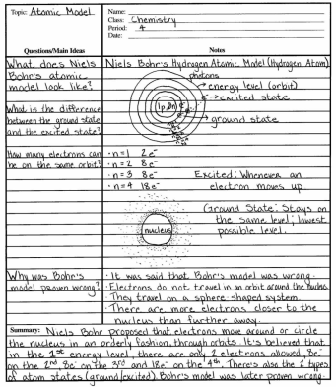
Lesson Title
Essential Question: Insert essential question here.
Study
Questions
Topic
Notes
Instructions
LG:

Slide 44
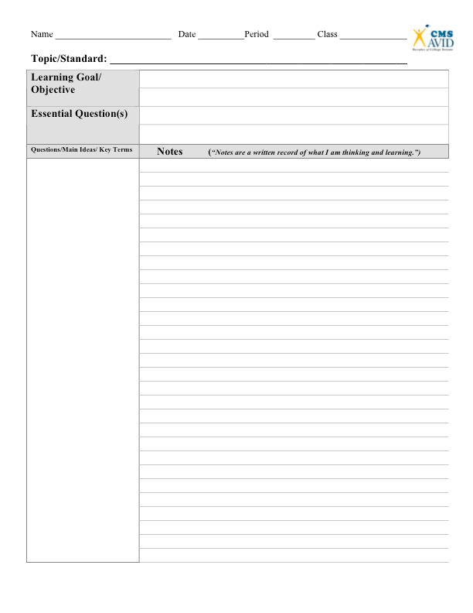

Slide 45
The Moral Side of Murder
EQ: Does the morally right thing to do depend upon the situation?
Study
Questions
Instructions: Take notes on the right-hand side while watching the video. Do your best--you will opportunities to discuss what you have written and head throughout the lesson.
LG:
Topic
Notes

Slide 46
The Case for Cannibalism
EQ: How should the jury rule in this case? Why? What would Jeremy Bentham say?
Study
Questions
Instructions:
Take notes on the right-hand side while you watch the video.
LG: Practice using the Cornell Way on a college lecture.

Slide 47
Tutor Introductions
LG: Get to know the tutors and understand their role in AVID.
EQ: Who are the tutors and how will they help us this year?

Slide 48
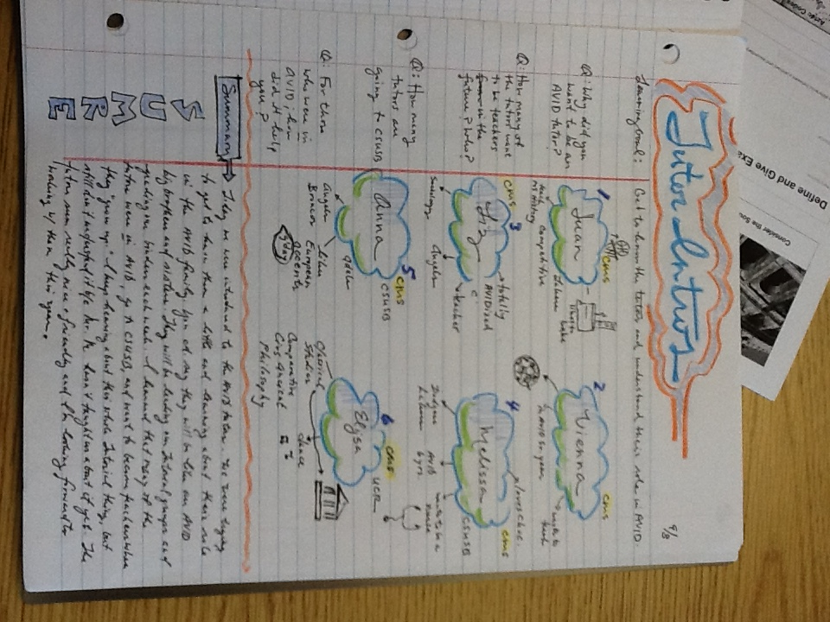
Tutor Introductions
EQ: Who are the tutors and how will they help us this year?
Study
Questions
Instructions:
You will practice using a bubble map/web off the word to keep track of new information today.
You will have 5 minutes per station to get to know the tutors.
Info
Info
LG: Get to know the tutors and understand their role in AVID.
Tutor's Name
Info
Info
Info
Info

Slide 49
Tutor Introductions
EQ: Who are the tutors and how will they help us this year?
Study
Questions
Tutors:
Bio information-- schools attended, what studying in college? What want to do with life?
AVID Experiences-- Why an AVID tutor? How long? What was your experience in AVID?
Any other fun information about yourself-- likes, dislikes, teams, favorites in any area of life, music, TV shows, music
What is your passion?
Students:
Don't ask anything sketchy.
What is your pet peeve as a tutor?
LG: Get to know the tutors and understand their role in AVID.

Slide 50
Tutor Introductions
EQ: Who are the tutors and how will they help us this year?
Study
Questions
Instructions:
Write left side questions about your notes.
Write a summary of your notes (DLIQ)
LG: Get to know the tutors and understand their role in AVID.

Slide 51
The Case for Cannibalism
EQ: How should the jury rule in this case? Why? What would Jeremy Bentham say?
Study
Questions
Debrief the Note-Taking Experience
What were some of the challenges you experienced while taking notes from the lecture?
Which step is most challenging? (CORNELL)
What did the steps RNELL do to help your comprehension/understanding of the material?
Which of your classes are easiest/hardest to take notes in for you?
LG: Practice using the Cornell Way on a college lecture.

Slide 52
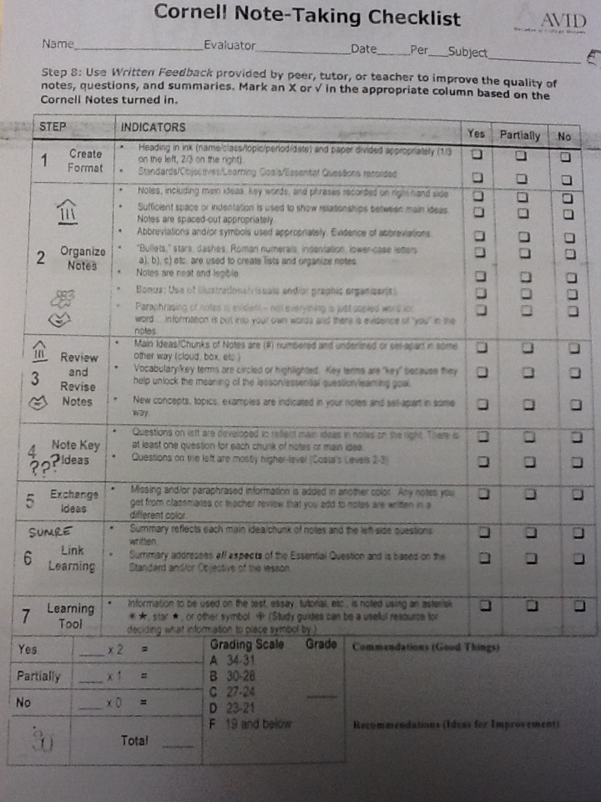
The Case for Cannibalism
EQ: How should the jury rule in this case? Why? What would Jeremy Bentham say?
Study
Questions
Evaluate Your Notes
Exchange notes with another student and use the rubric to evaluate their notes.
Q: What good things did you see in your partner's notes?
Q: What did YOU learn about Cornell Notes from using the rubric?
LG: Practice using the Cornell Way on a college lecture.

Slide 53
The Cornell Way
1. Create format
*Be sure to identify and write the standard/objective and essential question, if given.
*Set up for the essential question no matter what!

Slide 54
The Cornell Way
2. Organize notes on right hand side
*Skip lines in-between main ideas.
*Take notes in your own words, paraphrase when possible.
*Use bullet-points.
*Include visuals and graphic organizers to help process new information.

Slide 55
The Cornell Way
3. Review and revise notes
*Use a different color when revising notes.
*As you re-read your notes tonight (10 of 10-24-7), circle key terms, underline main ideas, and # main ideas.
*Draw in arrows to make connections among ideas in notes.
*Add drawings/visuals to notes.
key terms
#1
Main Ideas

Slide 56
The Cornell Way
4. Note key ideas to write
Questions
*Write a question on the left for each main idea you have underlined.
*Pull out key vocabulary.
*Nightly HW: At the end of each day, when you go home, you should review your revised notes and create a question for each chunk of notes (main ideas)
#1 Main Idea
Q:
key term
key term
Q:
#2 Main Idea
key term
key term
Q:
#3 Main Idea

Slide 57
The Cornell Way
5. Exchange ideas
*Collaborate (get together with) your peers to add to or revise your class notes.
*Use a different color writing utensil (diff. from orig.) to fill in any missing details.

Slide 58
The Cornell Way
6. Link learning by writing
a summary that addresses
the essential question and
main ideas
*Review notes taken and questions from the left-side to identify the main ideas from the lesson.
*Address the essential question in the summary.
*Use your left-side questions as a guide as you write your summary (write the answers).
*5-6 sentences is a good rule-of-thumb for summary writing.
*Your summary should show your understanding of the content and essential question.

Slide 59
The Cornell Way
7. Learning tool
Day1: 10 min. revise notes (different color) and write questions
24 hours later: Study your notes for another 10 min. Revise your notes.
7 days later: Study your notes again to maintain your understanding.
10
24
7

Slide 60
The Cornell Way
1. Create format
2. Organize notes on rhs
3. Review and revise notes
4. Note key ideas to write
Questions
5. Exchange ideas
6. Link learning by writing
a summary that addresses
the essential question and
main ideas
7. Learning tool
(use another color to do this)
(use original color to do this)

Slide 61
The Cornell Way
1. Create format
2. Organize notes on rhs
3. Review and revise notes
4. Note key ideas to write
Questions on Left
5. Exchange ideas
6. Link learning by writing
a summary that addresses
the essential question and
main ideas
7. Learning tool
(use another color to do this)
(use original color to do this)

Slide 62
The Cornell Way
1. C
2. O
3. R
4. N
5. E
6. L
7. L

Slide 63
Mrs. McGuffee Visit
LG: Examine the role of the counselor in my middle school experience.

Slide 64
Tutorial Reflection
LG:
EQ:

Slide 65
Tutorial Reflection
EQ:
Questions
CFU
Clarify
Expand
Notes
Notes
LG:

Slide 66
Writing Good Tutorial Questions
EQ: What steps do I go through to write good Tutorial questions?
Questions
CFU
Clarify
Expand
"A question is an invitation to think."
Notes
LG: Use the Costa's Levels of Questions handout to write a question for Thursday's Tutorial. Practice writing questions from various levels.

Slide 67
Tutorial Reflection
EQ:
Questions
CFU
Clarify
Expand
The Answers...........
Notes
LG:

