Slide 1
AVID Training Camp
Essential Question: what is AVID and what will we be doing on AVID in the 1st quarter?
Study
Questions
Training Camp
What experiences do you have with training camp? Brainstorm in your notes everything your table knows about training camp.
2. What is the goal/are the goals of training
camp?
LG: Become familiar with the mission of AVID and make connections between a training camp and what we will do in the 1st quarter.
We will use the theme/analogy of training camp to define or work in the first quarter.

Slide 2
Training Camp Overview
Essential Question: what is AVID and what will we be doing on AVID in the 1st quarter?
Study
Questions
Training Camp
As you watch this clip from the movie "Remember the Titans," keep track of of the various elements of training camp you see. Keep in mind the telos (purpose/goal) of what they are doing.
Video Clip | AVID Class
* Coach has a play book everyone must know. * Sets high goals. * Interview each other * Works them hard to achieve perfection. * Instill a "new normal" | * learn AVID essentials * understand our mission in AVID and set goals for the year * lots of team-building activities to break down barriers * get in academic shape *
What did the coach do @ training camp?
Why did he do it?
What were the results? What changes did you see in the team?
What barriers did the coach and team face?
LG: Become familiar with the mission of AVID and make connections between a training camp and what we will do in the 1st quarter.

Slide 3
AVID Training Camp
Essential Question: what is AVID and what will we be doing on AVID in the 1st quarter?
Study
Questions
Philosophical Chairs
The coach (Coach Boone) is too hard on the players.
Instructions
Do you agree or disagree with this statement? Explain your response in your notes.
LG: Become familiar with the mission of AVID and make connections between a training camp and what we will do in the 1st quarter.

Slide 4
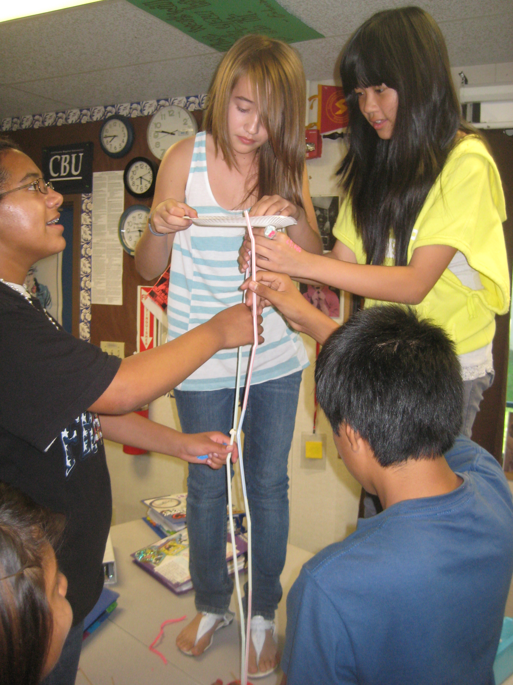
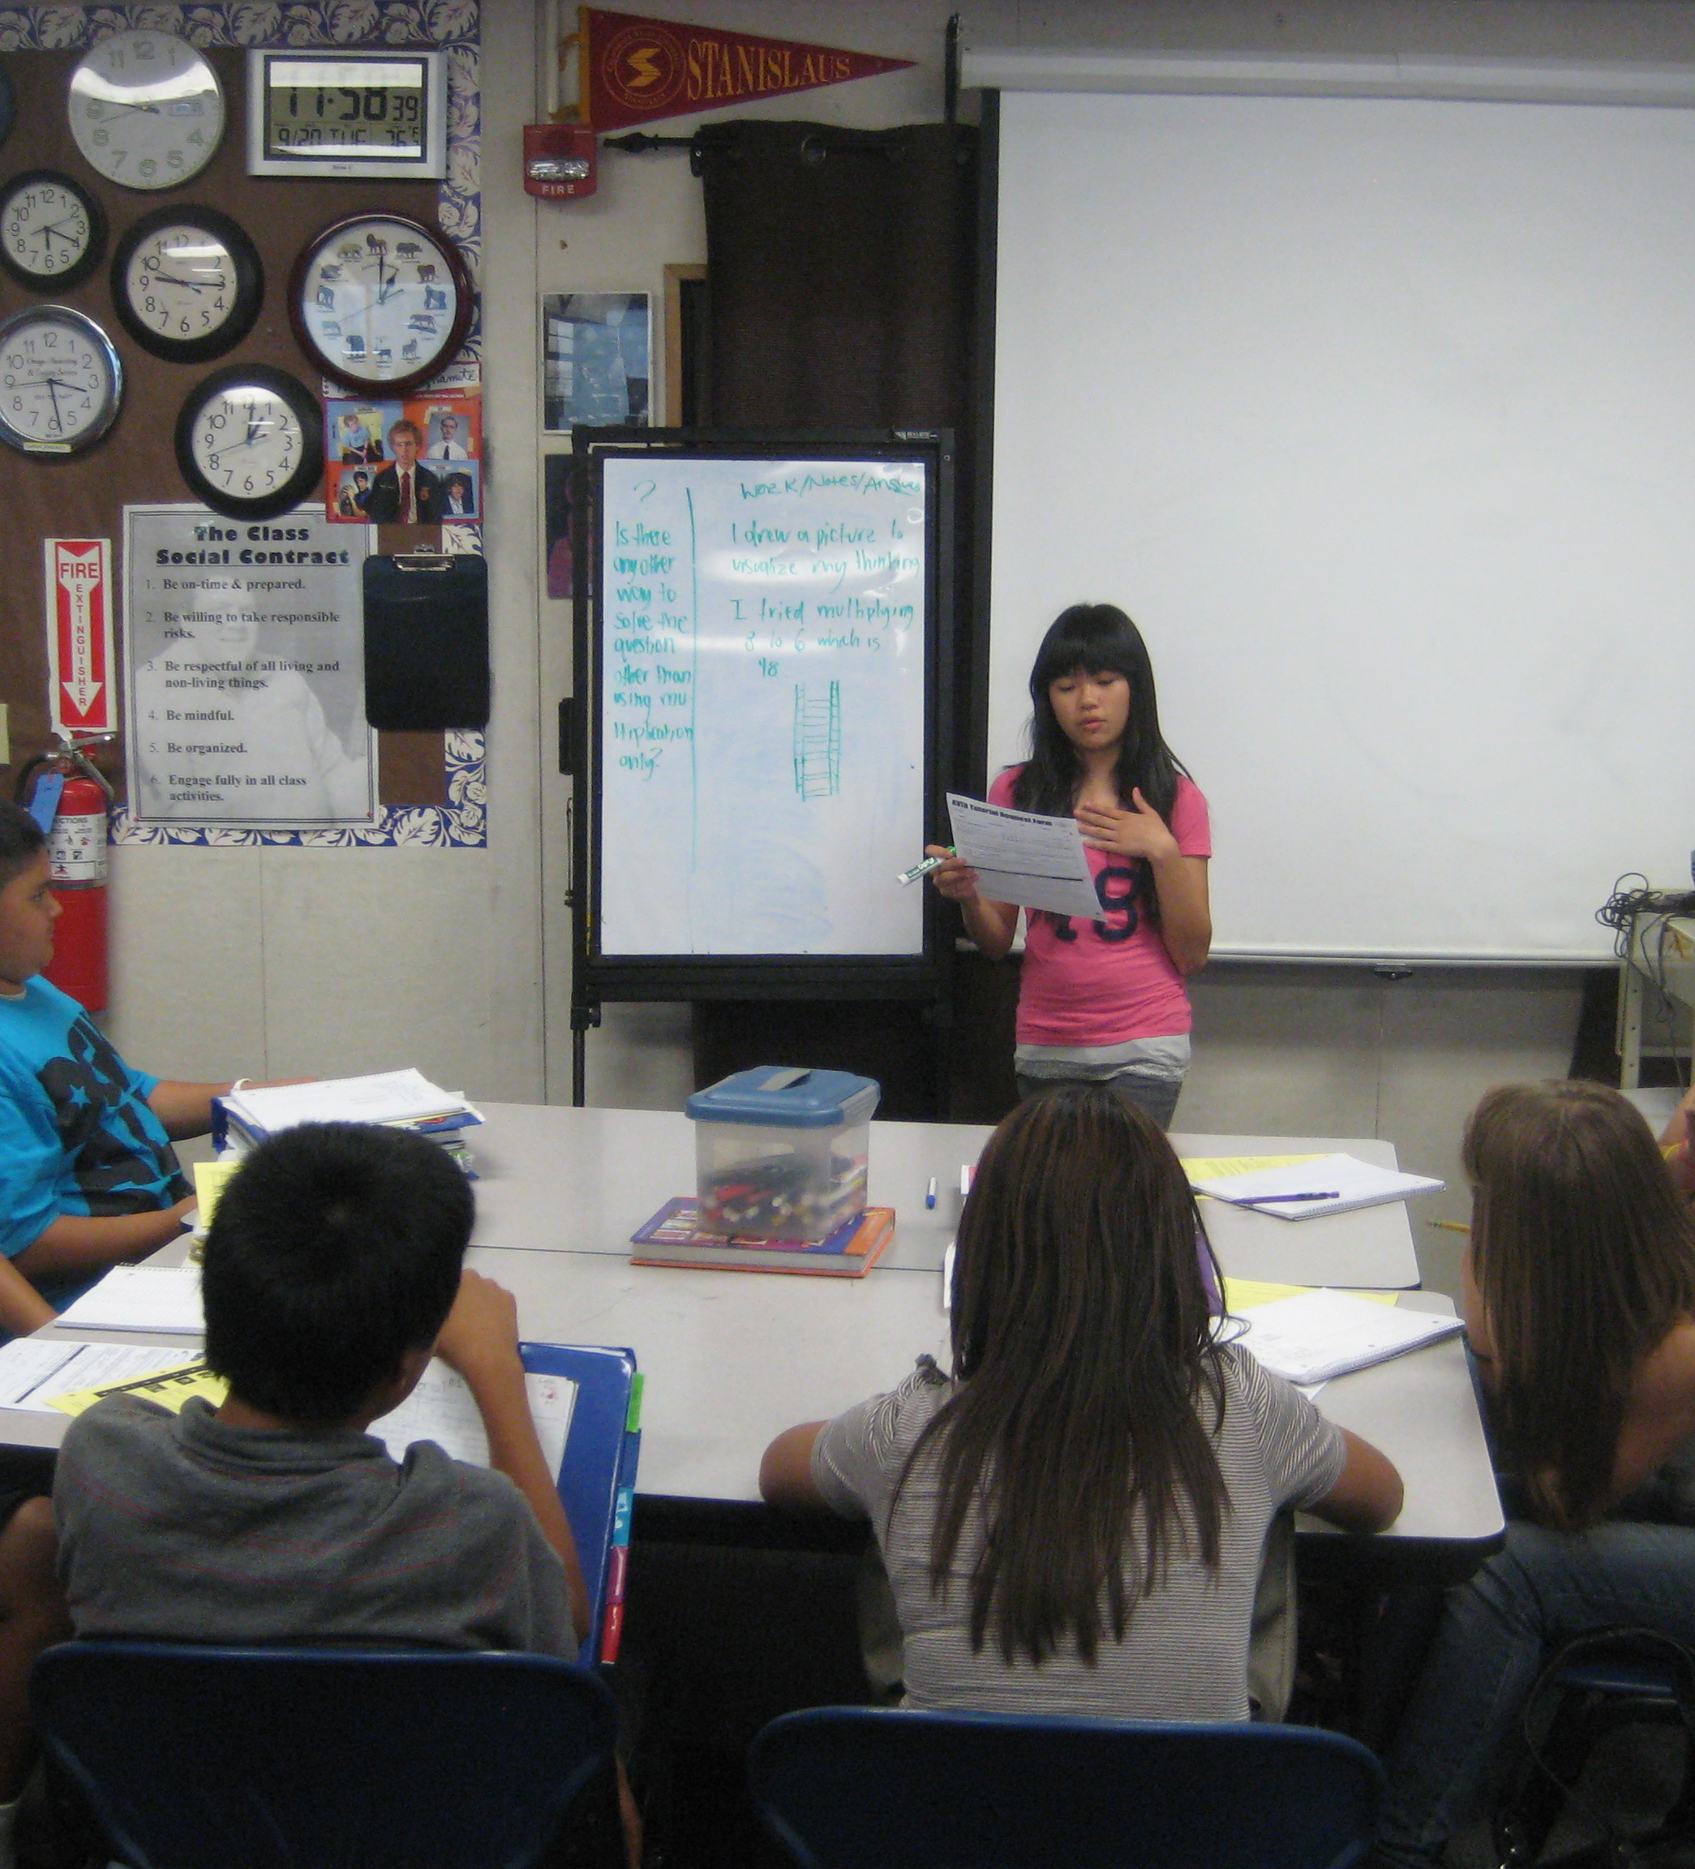
AVID Training Camp
Essential Question: what is AVID and what will we be doing on AVID in the 1st quarter?
Study
Questions
AVID Essentials
Cornell Notes
Tutorials
Binder Organization and Evaluation
Group Identity
LG: Become familiar with the mission of AVID and make connections between a training camp and what we will do in the 1st quarter.

Slide 5
AVID Training Camp
Essential Question: Insert essential question here.
Study
Questions
A Typical Week in AVID
Notes
Monday | Tuesday | Wednesday | Thursday | Friday
Projects, AVID curriculum, academic skill-building, critical reading and writing | Tutorials | Projects, AVID curriculum, academic skill-building, critical reading and writing | Tutorials, Binder Check | Team-building, Guest Speakers, Structured Discussions, College Research
Instructions
LG: Become familiar with the mission of AVID and make connections between a training camp and what we will do in the 1st quarter.

